Slide 1
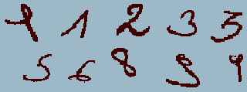
Hand written digit recognition

Slide 2
INTRODUCTION
A lot of money is wasted on converting the information that is in paper to digital format. This problem can be solved by using handwritten digits .
The heart of our project lies within the ability to develop an efficient algorithm that can recognize the handwritten digits
Handwritten digit recognition is the ability of a computer to
recognize the human handwritten digits from different
sources like images, papers, touch screens, etc, and classify
them into 10 predefined classes (0-9).

Slide 3
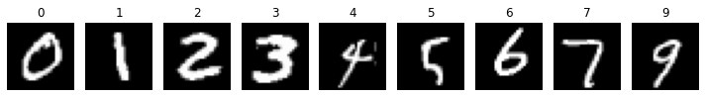
Dataset
MNIST (Modified National Institute of Standards and Technology database) why mnist data ?
which include major learning datasets,popular algorithms, features scaling & feature extraction methods.
MNIST contains a total of 70,000 handwritten
digit images (60,000 - training set & 10,000 - test set) in 28x28 pixel

Slide 4
Strengths:
Simplicity: MNIST is a simple and well-structured dataset with grayscale images of handwritten digits (0-9) and corresponding labels.
Standardization: MNIST has been widely used in the machine learning community
Availability: MNIST is easily accessible and comes pre-packaged with popular machine learning libraries
Weaknesses:
Limited Complexity: MNIST is a relatively simple dataset, consisting of grayscale images of isolated digits
Small Size: MNIST contains only 60,000 training samples and 10,000 test samples. This small size may result in models quickly achieving high accuracy

Slide 5
Pre-Processing:
Pre-processing is an initial step in the machine and deep learning which focuses on improving the input data by reducing unwanted impurities and redundancy. To simplify and break
down the input data all the images present have been reshaped in 2-dimensional images i.e (28,28,1).
Each pixel value of the images lies between 0 to 255 followed by Normalizing these pixel values by converting the dataset into 'float32' and then dividing by 255.0 so that the input features will range between 0.0 to 1.0. Next, one-hot is performed encoding to convert the y values into zeros and ones, making each number categorical, for
example, an output value 4 will be converted into an array of zero and one i.e [0,0,0,0,1,0,0,0,0,0].

Slide 6
Handwritten
digit recognition
using
Support Vector Machine
(SVM)
Convolutional Neural Network
(CNN)
Multilayer Perceptron
(MLP)

Slide 7
Support Vector Machine (SVM)
Support vector machines (SVMs) are a type of supervised learning algorithm that can be used for both classification and regression tasks. In image classification, SVMs are typically used to find a hyperplane that separates two or more classes of images. The hyperplane is a line or plane that divides the feature space such that the classes are on opposite sides.
The goal of SVMs is to find a hyperplane that maximizes the margin between the classes, which means that the distance between the hyperplane and the closest points of each class is as large as possible.
This helps to ensure that the classifier is robust to noise and outliers.
SVM chooses the extreme vectors that help in creating the hyperplane. These extreme cases are called support vectors, and hence the algorithm is
termed as Support Vector Machine.
There are mainly two types of SVMs, linear and non-linear SVM. In this paper, we have used Linear SVM for handwritten digit recognition

Slide 8
To use SVMs for image classification, we first need to extract features from the images. These features can be the color values of the pixels, edge detection, or even the textures present in the image.
Once the features are extracted, we can train an SVM classifier to find a hyperplane that separates the classes.
SVMs have been used successfully for image classification in a variety of applications, including face recognition, object detection, and medical image analysis. They are a powerful tool that can be used to classify images with high accuracy.
Here are some of the advantages of using SVMs for image classification:
SVMs are very accurate.
They can achieve high accuracy even with small datasets.
SVMs can be sensitive to the choice of features. This means that it is important to choose features that are relevant to the task at hand.
Overall, SVMs are a powerful tool that can be used to classify images with high accuracy.

Slide 9


Slide 10
Convolutional Neural Network (CNN)
A Convolutional Neural Network (CNN) is a type of deep learning model commonly used for image classification and computer vision tasks. It is designed to automatically learn and extract meaningful features from images by utilizing convolutional layers, pooling layers, and fully connected layers. Here's a simplified explanation of the key components and classes commonly found in a CNN:
CNN contains 3 layers namely, an input layer, an output
layer, and multiple hidden layers which include
Convolutional layers, Pooling layers(Max and Average
pooling), Fully connected layers (FC), and normalization
layers

Slide 11
CNN layers
Convolutional Layer (Conv2D)
Pooling Layer (MaxPooling2D)
Flatten Layer
Fully Connected Layer (Dense)

Slide 12
Convolutional Layer (Conv2D)
2. Pooling Layer (MaxPooling2D)
A Conv2D layer performs a convolution operation on the input image.
The primary aim of this layer is to decrease the size of the convolved feature map
Each filter slides across the image, performing element-wise multiplication and summing up the results to produce a feature map.
MaxPooling2D takes the maximum value within a certain window (usually 2x2) to downsample the feature map.
3.Fully Connected Layer (Dense):
is used to connect the neurons between two different layers.
The output of the last dense layer is typically fed into a softmax activation function for classification tasks

Slide 13
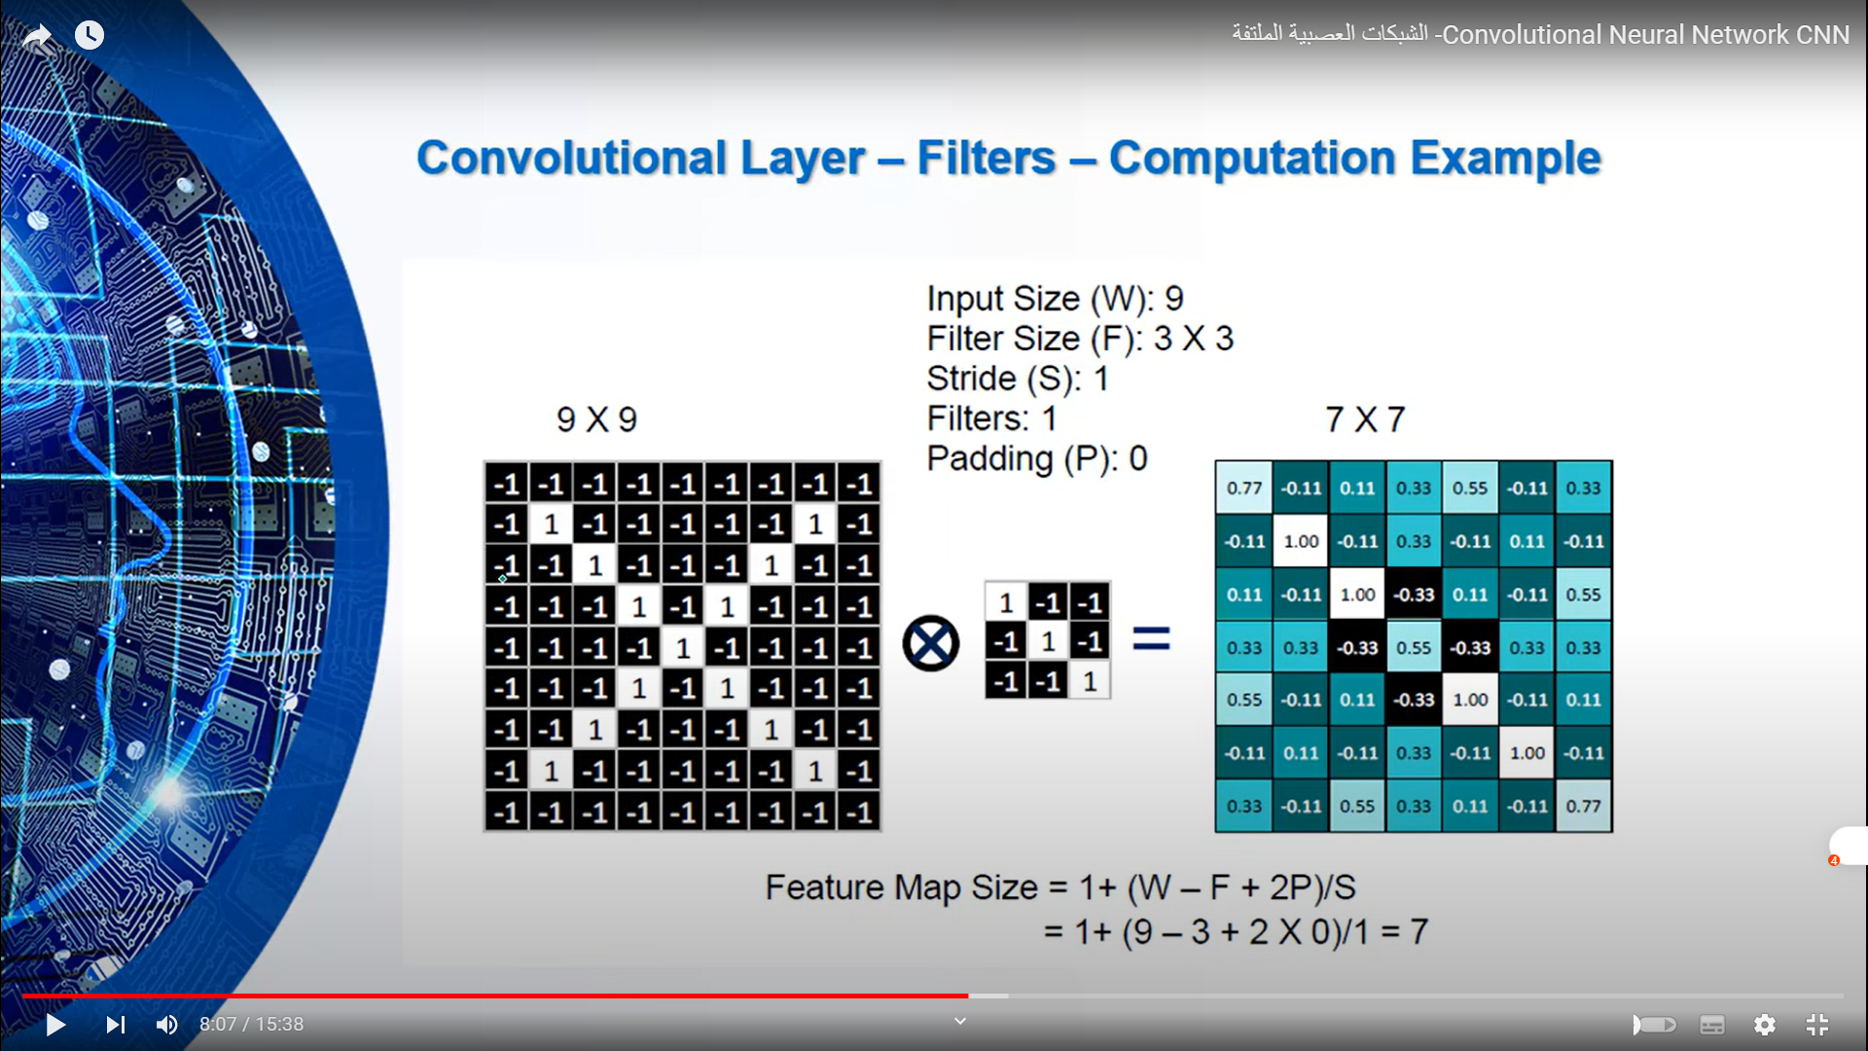

Slide 14
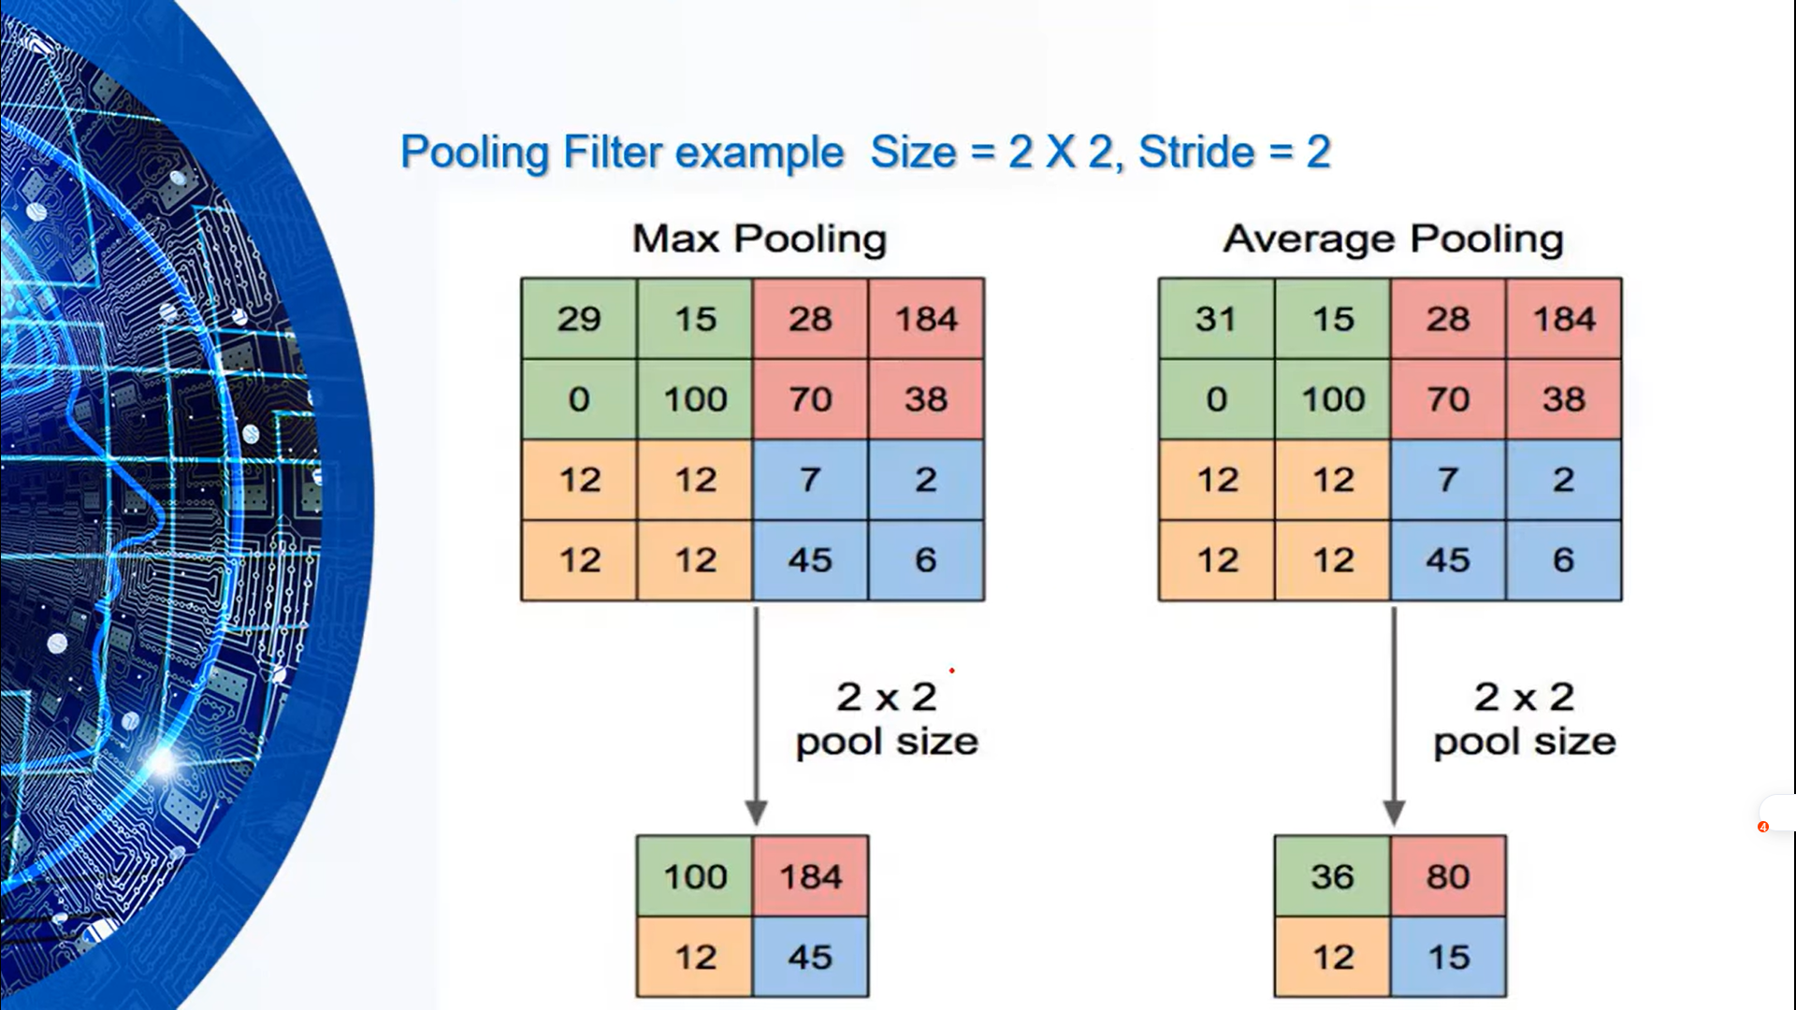

Slide 15
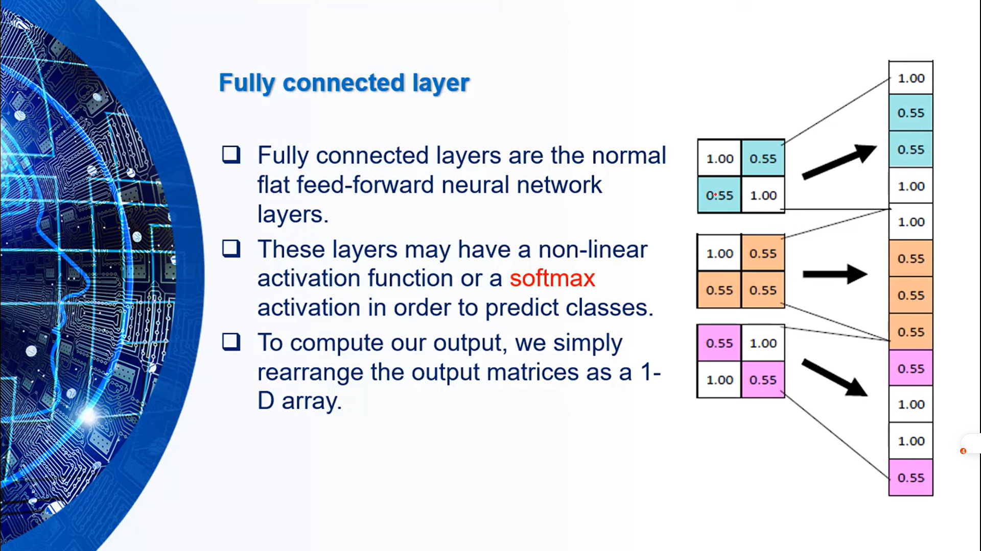

Slide 16
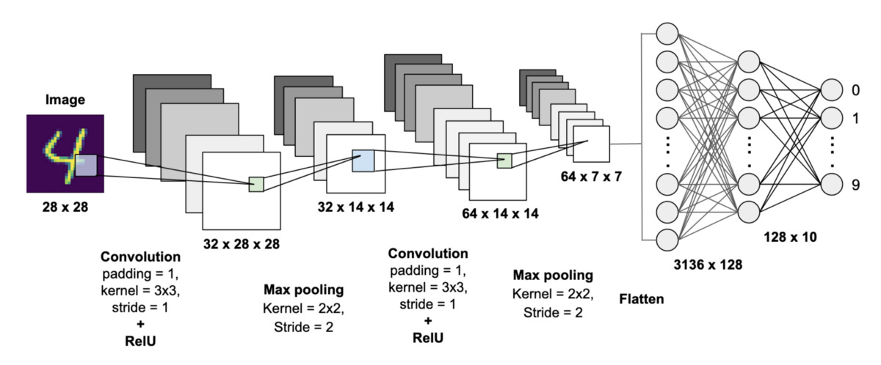
note
feature map size= 1+(W-F+2P)/S
w = input size , F = filter
p = padding , S = stride
ReLU(x) = max(0, x)
the dropout layer randomly drops out a fraction of the input units during training that helps combat overfitting in neural networks and improves their ability to generalize to new, unseen data.

Slide 17
In General
Strengths:
Weaknesses:
Use of standard libraries
Lack of hyperparameter tuning: The code uses default hyperparameters for the model training, such as batch size, number of epochs,
Proper data preprocessing: The code properly preprocesses the input data by reshaping the images and normalizing the pixel values,
Limited model evaluation: The code only evaluates the model on the test set using accuracy and loss metrics
Convolutional Neural Network architecture: The code implements a CNN architecture that is suitable for image classification tasks, consisting of convolutional layers, max pooling layers, and fully connected layers.

Slide 18
TEAM name : AM94
Abdelkhalek mohamed abdelkhalek
MOhamed Ramdan Abdelbaki
221101029
221101054
Dr.prof /Ahmed Emam
Eng / Ismail Ahmed

Slide 19
Thank YOU

